Slide 1
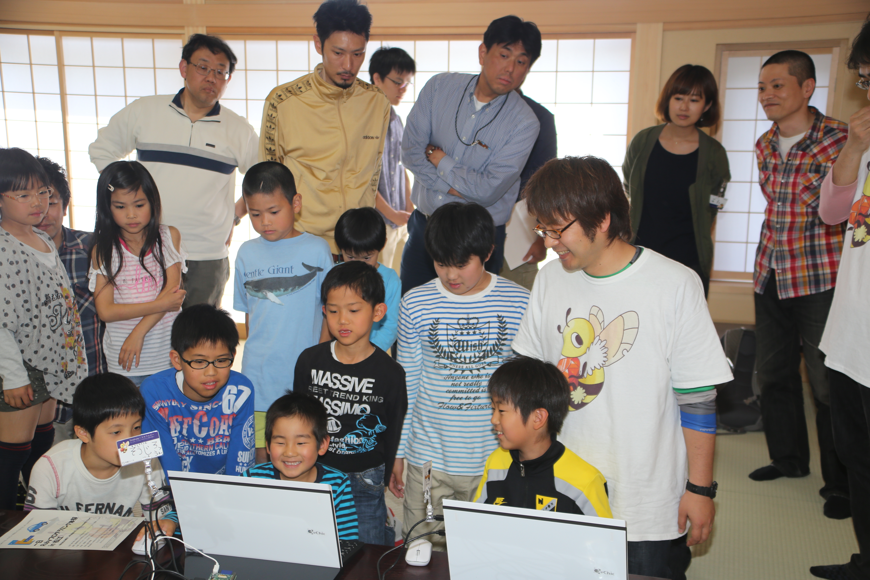

Kids, Ruby, Fun!
Introduction of the Smalruby and Ruby Programming Shounendan
Kouji Takao,
The Ruby Programming Shounendan,
RubyConf 2014, 11.19.2014
Notes:
Hi, everyone, How are you?
Thank you for attending. This presentation is called “Kids, Ruby, Fun!”.
I’ll discuss our activities with the Ruby Programming Shounendan, especially *Smalruby* which is *a key part* of it.
Here we go!

Slide 2
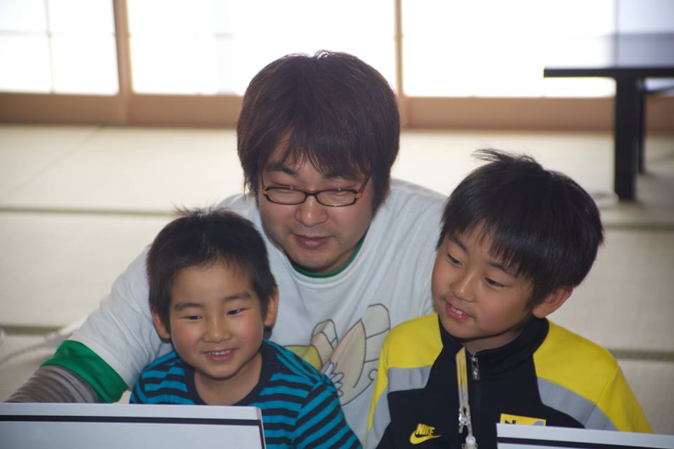
Kody : Kouji Takao
CRuby commiter (Readline module)
A leader of the Ruby Programming Shounendan Shounen = Boys & Girls Dan = Organization
Notes:
I’m Kody, Kouji Takao, one of the CRuby commiters, and a leader of the Ruby Programming Shounendan.
Shounendan is a Japanese word. “Shounen” means boys and girls, “Dan” means an organization, so “Ruby Programming Shounendan” means a boys and girls organization for leaning Ruby programming.

Slide 3
Kody : Kouji Takao
Engineer of NaCl
Network Applied Communication Laboratory
Contact kouji@smalruby.jp @takaokouji_en Facebook
Notes:
Also, I’m a research engineer at Network Applied Communication Laboratory, aka NaCl.

Slide 4
Made possible by
NaCl
Notes:
This presentation is made possible by NaCl.
NaCl, of course, is famous for being *Matz’s employer*.

Slide 5

NaCl is in
Matsue, Shimane, Japan
http://en.wikipedia.org/wiki/File:Japan_location_map_with_side_map_of_the_Ryukyu_Islands.svg : Maximilian Dörrbecker (Chumwa) CC-BY-SA 3.0CC by SA
Notes:
The headquarters of NaCl, is located in Matsue-city, Shimane Prefecture of Japan.
Matsue is a city of about two handled thousand (200,000) people near Hiroshima.

Slide 6
Please
visit
NaCl♪
http://en.wikipedia.org/wiki/File:Japan_location_map_with_side_map_of_the_Ryukyu_Islands.svg : Maximilian Dörrbecker (Chumwa) CC-BY-SA 3.0CC by SA
Notes:
Please visit NaCl in our idyllic provincial city, Matsue, if *you are interested*.
Okay, So I’ll return to the main topic.

Slide 7
6 years ago,
Notes:
Six (6) years ago,

Slide 8
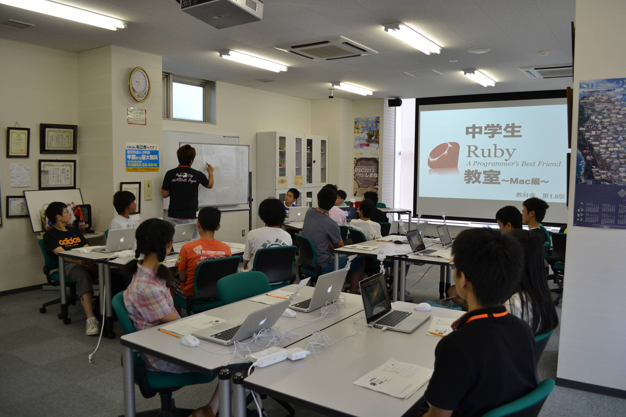
Started to Teach Ruby for youth
Notes:
I started to teach Ruby programming for junior high school students. In Japan, junior high school is for *three (3) years*.

Slide 9
Motivations
Ruby City MATSUE Project
TEACH MY SON RUBY
Notes:
My motivations were
<press>
the Ruby City MATSUE project and
<press>
to teach my son Ruby.

Slide 10

Ruby City MATSUE Project
By Matsue-city
Promote IT Business
Increase Rubyists
Find Ruby teachers
Matsue Mayer
Masataka Matsura
Image from http://www.matsuura-m.jp/
Notes:
The Ruby City MATSUE Project
<press>
was managed by the city government.
Matsue Mayer Masataka Matsura hoped to help Ruby community because Matz, who created Ruby, lives in Matsue, and Ruby generated new business,
<press>
so the government decided to promote IT business using Matz and Ruby in Matsue!
Then the government started this project to help IT businesses. Also, IT businesses require many IT engineers.
<press>
So one purpose of the project was to increase the number of Rubyists in Matsue
<press>
6 years ago, the project was looking for teachers that could teach Ruby to the youth.

Slide 11
TEACH MY SON RUBY
Love Ruby
Love IT Engineering
Make materials for teaching Ruby to youth
Notes:
My second goal was *my real motivation*.
<press>
I love Ruby
<press>
and IT engineering, so I plan to *teach my son Ruby* to become an IT engineer when he grows up.
However, 6 years ago, I did not have any tools or materials for teaching Ruby to youth, also KidsRuby did not exist at that time.
<press>
So, I decided to make tools and materials for teaching Ruby to youth.

Slide 12
Started to Teach Ruby for youth
Find Ruby teachers
Make materials for teaching Ruby to youth
+
Notes:
So, I started to teach Ruby to youth *six (6) years ago*.

Slide 13
Since then
1% / year
in Matsue-city
Notes:
Since then, I have taught Ruby to over two handled fifty (250) junior high school students. This number is … *low* :-<
<press>
However, *only five thousand five handled (5,500) junior high school students live in Matsue-city, so I teach about *1%* junior high school students in Matsue-city *each year*.
That’s good, right?

Slide 14

Ruby is
AND KIDS?
A Programmer’s
Best Friend
Notes:
Now,
how is Ruby *for programming education*?
As you know, Ruby is *"A Programmer's best friend“*.
Ruby:
* has Simple syntax,
* is Object-oriented and
* has a Garbage collector.
<press>
So I *believe* it’s the same *for kids* who want to start to code.

Slide 15
Problems
Typing
English
Ruby Syntax
Notes:
In these six (6) years teaching ruby in Japan, I’ve encountered these problems:
<press>
First, typing is difficult. Most kids don’t know how to make use of *Symbols*, pressing “shift + ,” is hard!
<press>
Second, *English*… English is hard… ☹ They can understand the roman alphabet, but *basic words* like “if”, “end”, “do” are *still challenging*.
<press>
Third, kids *don’t know* Ruby syntax and standard libraries. So, they aren’t able to work *on their own*,
which leads them to *slow down* the learning experience pace and *be frustrated*. It also increases the need for *more instructors* in the classroom.
Therefore, kids *often quit* before they realize that *programming is fun*.
This is a big problem for me!

Slide 16
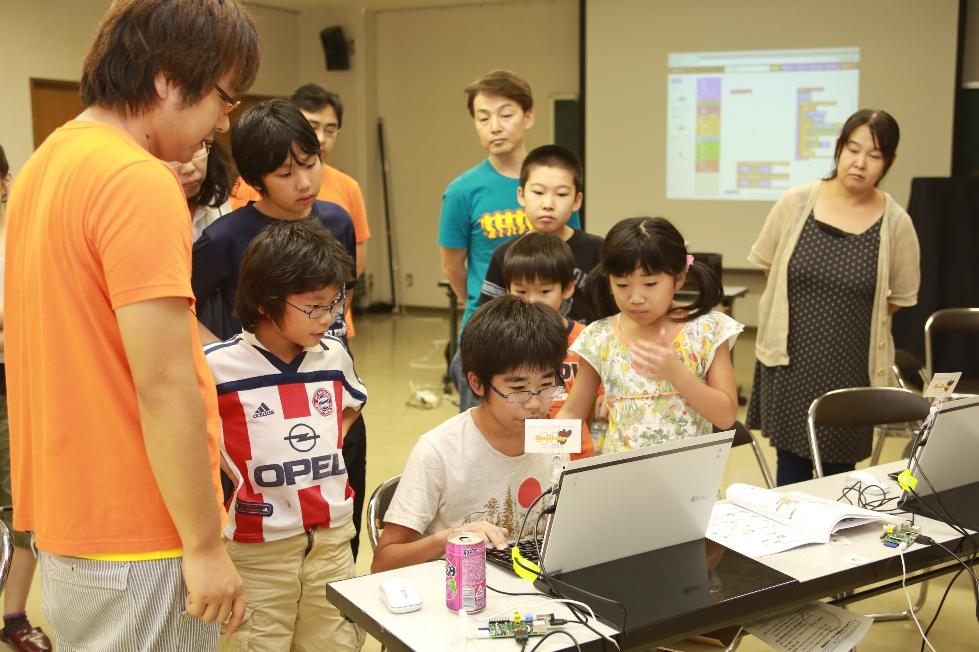
Recently,
Increased
Programming Education
Notes:
You know,
In the last few years,
programming education for elementary and middle school students, has increased world wide.

Slide 17

20,000 Teachers
“Should be a compulsory subject!” By President Obama
Notes:
Programming education is being done most actively in America.
<press>
In a New York Times article from May tenth (10), two thousand fourteen (2014), twenty thousand (20,000) teachers from kindergarten to high school incorporated programming classes into their curriculum.
<press>
In addition, President Obama has been saying that programming is necessary and should be a compulsory subject.
So hopefully this flow will accelerate.

Slide 18

Compulsory education for ages 5-16
Concept of algorithms Building and Debugging It is Practical!
Notes:
Next,
<press>
in September the United Kingdom officially introduced programming to the new compulsory education curriculum for ages five (5) to sixteen (16).
<press>
At the age of five (5), understanding of the concept of algorithms, building and debugging a simple program has been incorporated, so it’s practical.
There are movements to introduce programming education in many other countries.

Slide 19
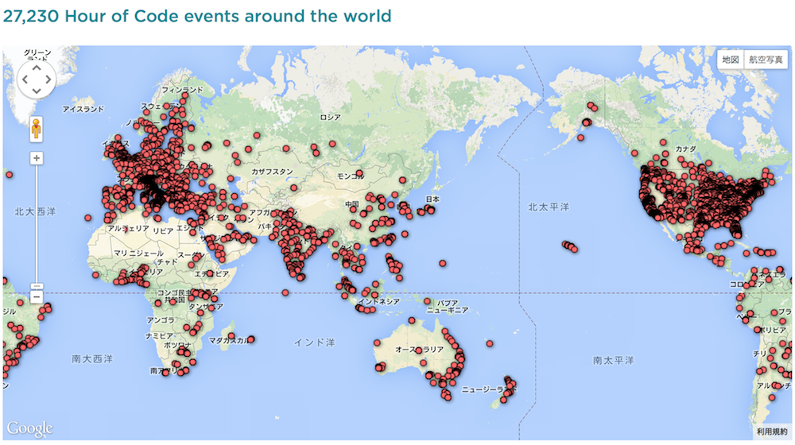
HOUR OF CODE by Code.org
27,230 events around the world
1,000 Teachers
100,000,000 Kids
http://hourofcode.com/
Notes:
One of them is “Hour of Code” project by Code.org.
The project's goal is
<press>
to train over ten thousand(10,000) teachers to effectively learn how to teach others how to code.
<press>
Soon after this initial step is done, it is expected that around one hundred million kids to be taught about programming by these trained professionals.
There are many famous people that believe in this project and donated for this cause, for instance , Mark Zuckerberg, facebook's CEO.

Slide 20
Japan
Notes:
Now,
I will introduce the situation in Japan.

Slide 21

Government
Notes:
First, about the Japanese government.

Slide 22
Compulsory Education
Junior high school / Since 2012
Notes:
Programming classes in junior high school has already been required since April two thousand twelve (2012).

Slide 23
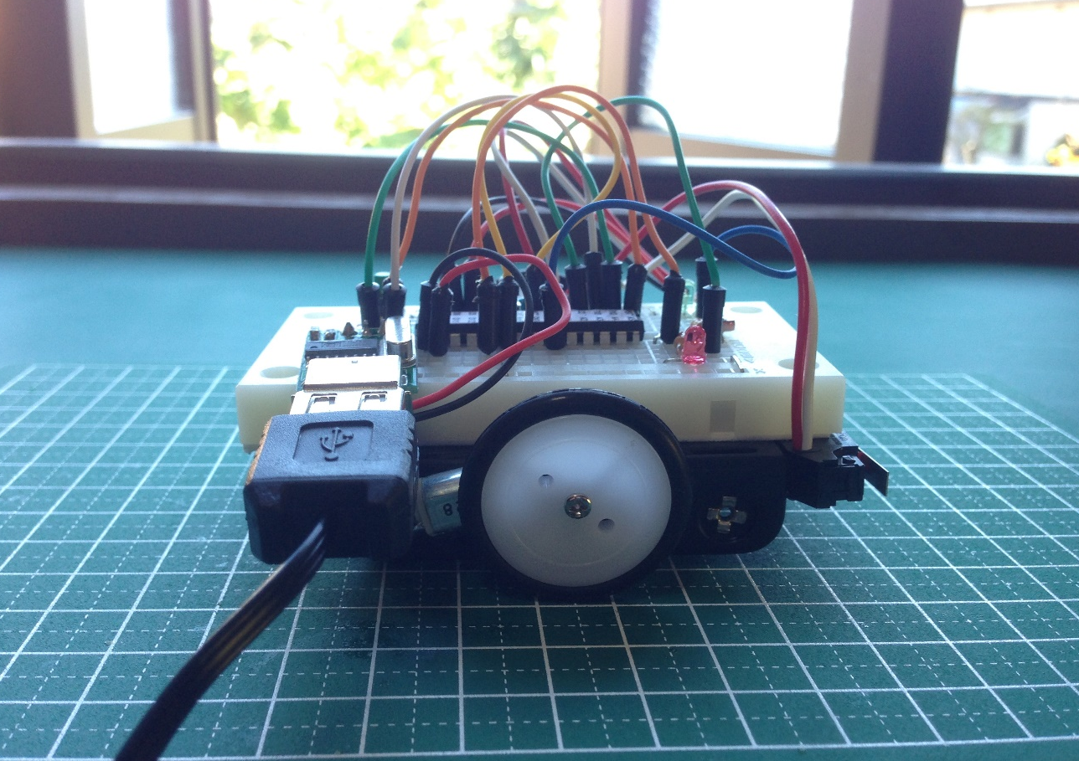
Measurement and Control
Sensor
Motor
Notes:
Its name is “Measurement and Control“.
In that class, projects that include controlling a small robot car are very popular.
For example, making this robot follow remote directions or to move while making use of different kinds of sensors are pretty common.

Slide 24
1 Computer / 1 Student
～2020
Ex) Distributed tablets to
all 6-12 ages in Saga-city
about 4,000 students
Notes:
Also, in two thousand eleven (2011), the Japanese government declared that by the year two thousand twenty (2020) every student would have access to their own computer.
<press>
For instance, this past April, the project distributed tablets to all elementary school students in Saga-city. The programming classroom schedule started on October twentieth (20th).
In these ways, information technology and the introduction of programming education will continue to increase…

Slide 25
Company
Notes:
At the same time, the activities of private companies have also been actively carried out.

Slide 26
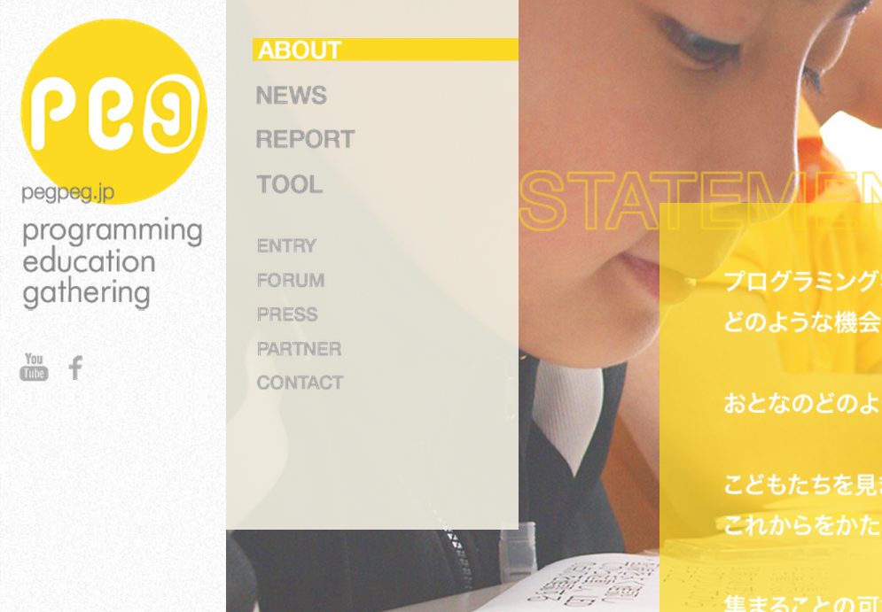
PEG
Joint project of CANVAS and Google
CANVAS hold many workshops for children
Distributed 5,000 Raspberry Pi
http://pegpeg.jp/
Notes:
Especially recently,
PEG which is a project to spread programming education, has become a hot topic.
<press>
PEG is a joint project of CANVAS and Google.
<press>
CANVAS is a Japanese NPO that has held workshops for children. It’s not only programming.
<press>
PEG has held programming workshops and has distributed five thousand (5,000) Raspberry Pi to education business owners in Japan.

Slide 27
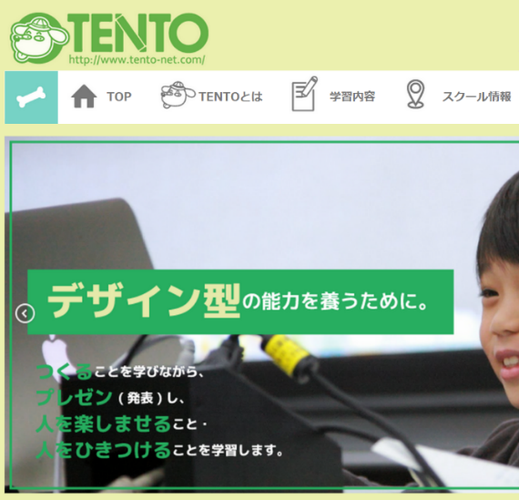

TENTO
Life is Tech!
Individualized
instruction
Boot camping
http://www.tento-net.com/
http://life-is-tech.com/
Programming education as a Service
= PaaS ;-)
Notes:
In addition, “TENTO” manages individualized instruction. “Life is Tech!” manages about five days boot camping and weekly school for programming.
“TENTO” and “Life is Tech!” receive a パティシィペーション (participation) fee or tuition, I just interesting is that they manages programming school as business.
Other than those discussed here, workshop of a variety of programming education has been held, programming education for youth has increased in Japan as well as overseas.

Slide 28
Why many kids programming workshops are held?
Great tools and materials!
Notes:
By the way,
do you think that why many kids programming workshops are held recently?
<press>
I believe that we have great tools and materials for teaching programming to youth.

Slide 29
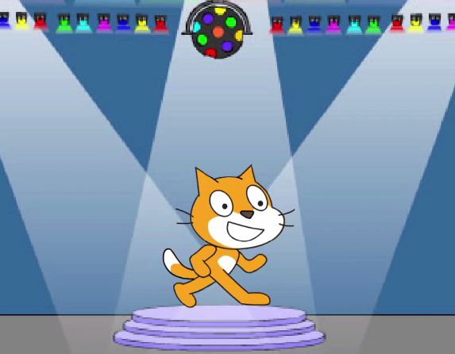

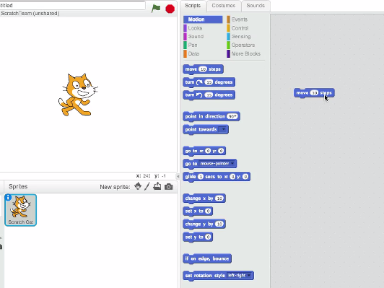

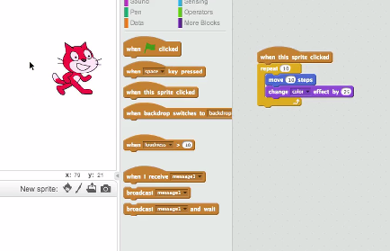

by MIT Media Lab
http://scratch.mit.edu/
http://vimeo.com/65583694
Notes:
Yes, it’s “Scratch”. “Scratch” is most famous programming education tool, right?
Scratch is a visual programming language and tool. MIT has developed it. It is used in the following classes and workshops of many programming. Scratch’s users are more than two million (2,000,000) worldwide.
In Japan, it has been most often used in the workshop of programming education in elementary and junior high school students.

Slide 30
Blocks
= Instructions
Combination
of blocks
= Program
Notes:
In Scratch,
<press>
instructions are blocks,
<press>
and combination of blocks describe your program,
so you are easy to find instruction and make program.

Slide 31
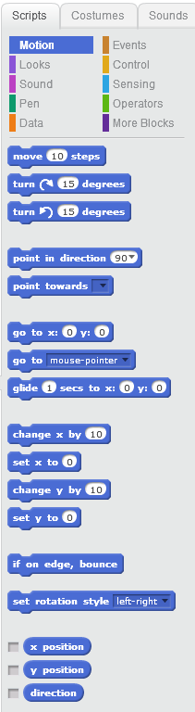
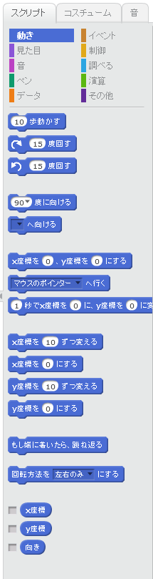
Internationalization
English
Japanese
Notes:
Also Scratch supports internationalization, so Japanese kids are easy to understand everything.

Slide 32
Easy to run
Press
Run
Notes:
If you want to run your program,
<press>
you only press the green flag on screen then your program starts to run.

Slide 33
Problems
Typing
English
Ruby syntax
➡Blocks
➡ Internationalization
➡ Combination of blocks
Notes:
So I believed that Scratch features will solve my problems.
<press>
Typing, instruction Blocks
<press>
English, internationalization
<press>
Ruby syntax, combination of blocks

Slide 34

Ruby + Scratch
Hi,
I’m Hatti!
Smalruby
(smɔ́ːrúːbi)
Notes:
So, we have developed Smalruby.

Slide 35
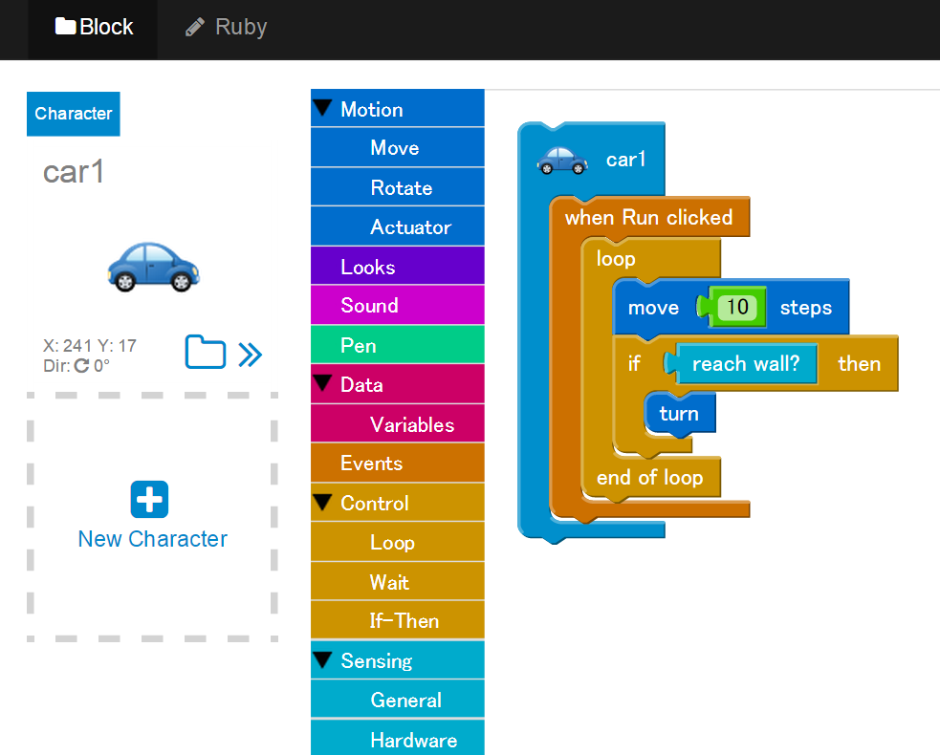
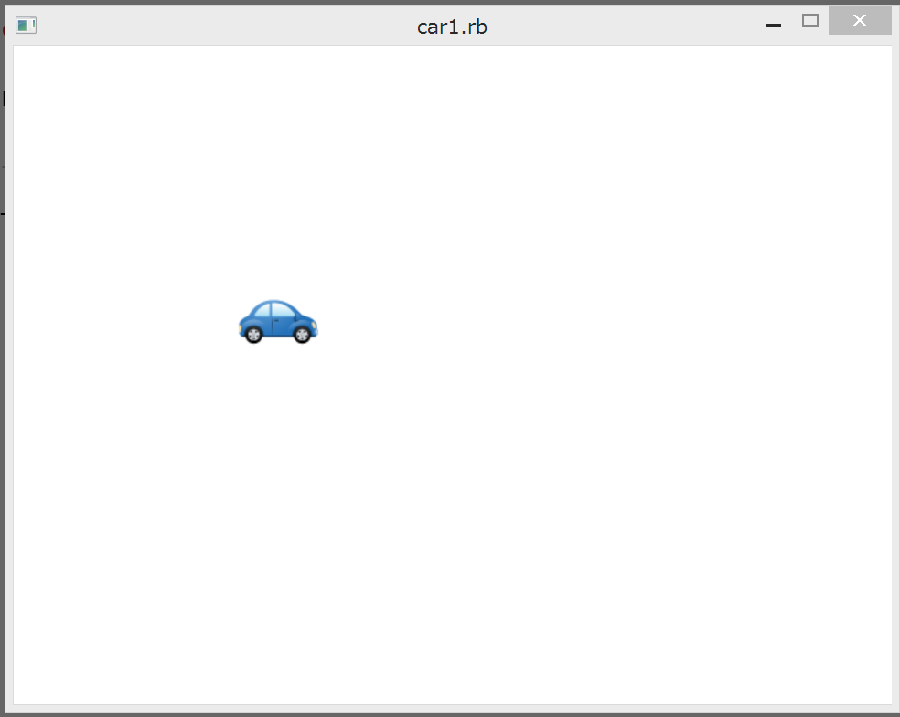
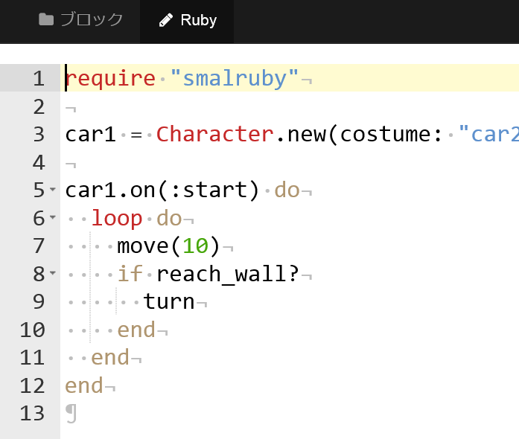
Demo
Notes:
Right now, I will show what is Smalruby.
(Highlight a character, then press the Enter button, “Ruby” button to place the instruction block, run the ruby in the background, the character will move.)
This is Smalruby.

Slide 36
Smalruby
(smɔ́ːrúːbi)
GitHub:
smalruby/smalruby-editor
Notes:
Smalruby:

Slide 37
Scratch Features
Instruction Blocks
Characters and Stages
Easy to Run
Notes:
Just like Scratch, Smalruby makes use of instructional blocks. By making use of characters and "stages", these blocks are very "easy to run".
Things like creating, updating and loading a file are very simple!

Slide 38
Instruction Block
Ruby
Notes:
Smalruby can convert instruction blocks to Ruby code.

Slide 39

Ruby
Instruction Block
Notes:
Smalruby is also able to transform Ruby code to Instruction blocks !
This 2 way communication is an interesting add for a visual programming editor. I believe this is a very special feature, and it was implemented because of some interesting experiences that we’ve had.

Slide 40
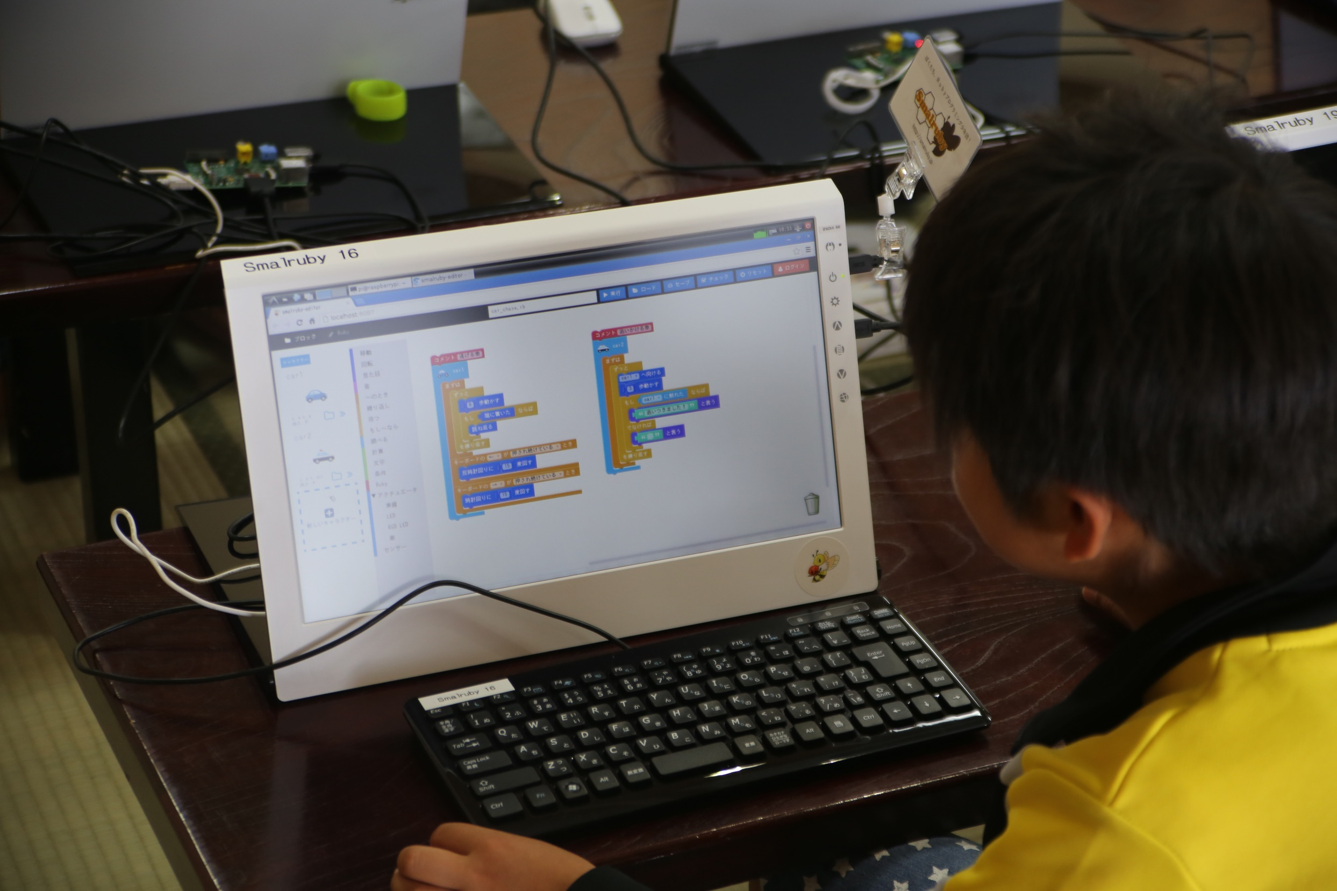
KIDS WANTED TO CODE DIRECTLY!
Notes:
While I was teaching programming for kids using an earlier version of Smalruby, a very interesting situation constantly happened.
Some kids would want to take the programming experience one step further, they wanted to implement more features to their programs. Create programs like … how to find a prime number! Or making a new programming language ( Was that “matz” kid ? haha).
The instruction blocks were not enough and they wanted more !
<press>
They wanted to enter the code directly !
Because of that, I realized that kids wished to code.
So I thought that by making Smalruby able to make use of both code and instruction blocks while linking the information, would be a great add for these kids experience by allowing them to transition more naturally to “hard coding” in their own pace and slowly get introduced to the ruby syntax and standard library.

Slide 41



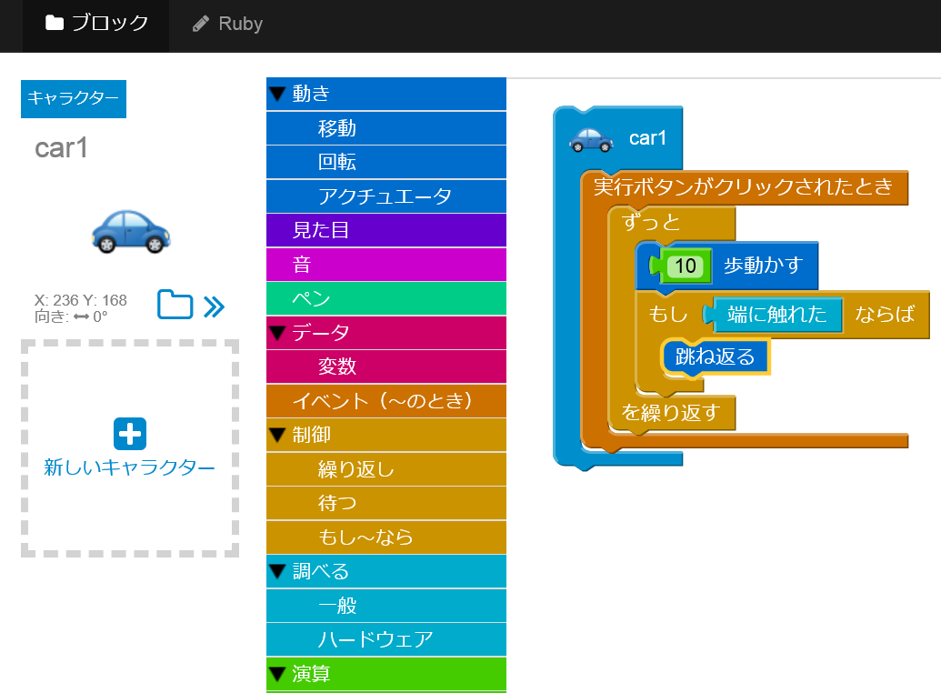
Vim Icon : http://www.vim.org/index.php
Emacs icon : http://ochiailab.blogspot.jp/2013/04/powerlineelemacs.html
Sublime Text icon : http://blog.livedoor.jp/nonprofessional/archives/1004031653.html
Notes:
Once these kids have learned the fundamentals of programming using instruction blocks.
<press>
I plan to introduce them as soon as possible to coding and also helping them with handy programmer things.
Like picking an Editor !

Slide 42
Now
Notes:
Okay,
now that we have Smalruby, I believe I’ll have an easier for teaching them the coding fundamentals.

Slide 43
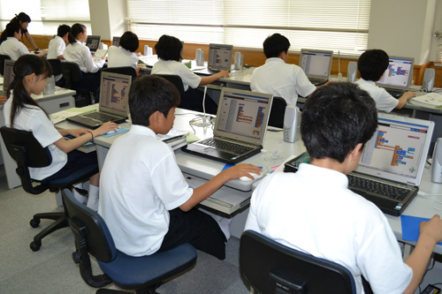
Experimental programming class using Smalruby
for 288 students
in this April
Photo from http://business.nikkeibp.co.jp/article/report/20141001/271963/
Notes:
In this April, we’ve held an experimental programming class using Smalruby. That class was designed for a group of about two handled eighty eight (288) junior high school students in Matsue-city.
They were divided in classes of thirty two (32) students and initially there was no educational guidance material for use. Since this was our first attempt, both teachers that worked in this experiment, learned how to use the program and then proceeded to created a textbook by themselves.

Slide 44

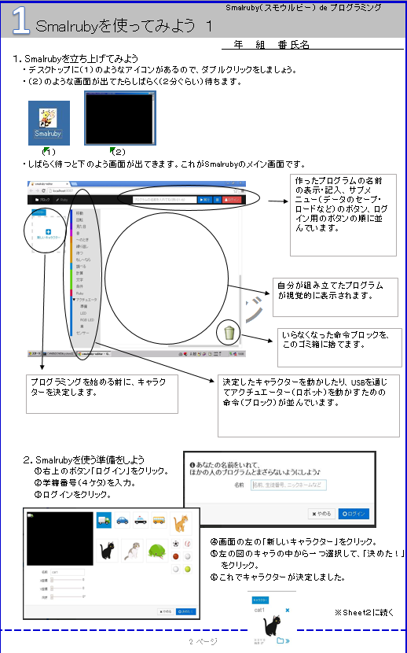
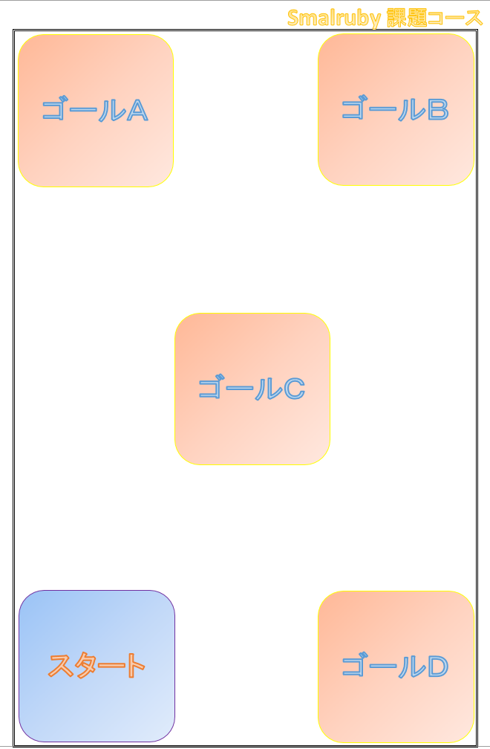
Made
educational material by both teachers who are not IT engineers!
Notes:
Even though they were not IT engineers, they thought it was easy to perform while using Smalruby. Learning the software and later, converting this knowledge into educational material seemed to be nice and easy.

Slide 45
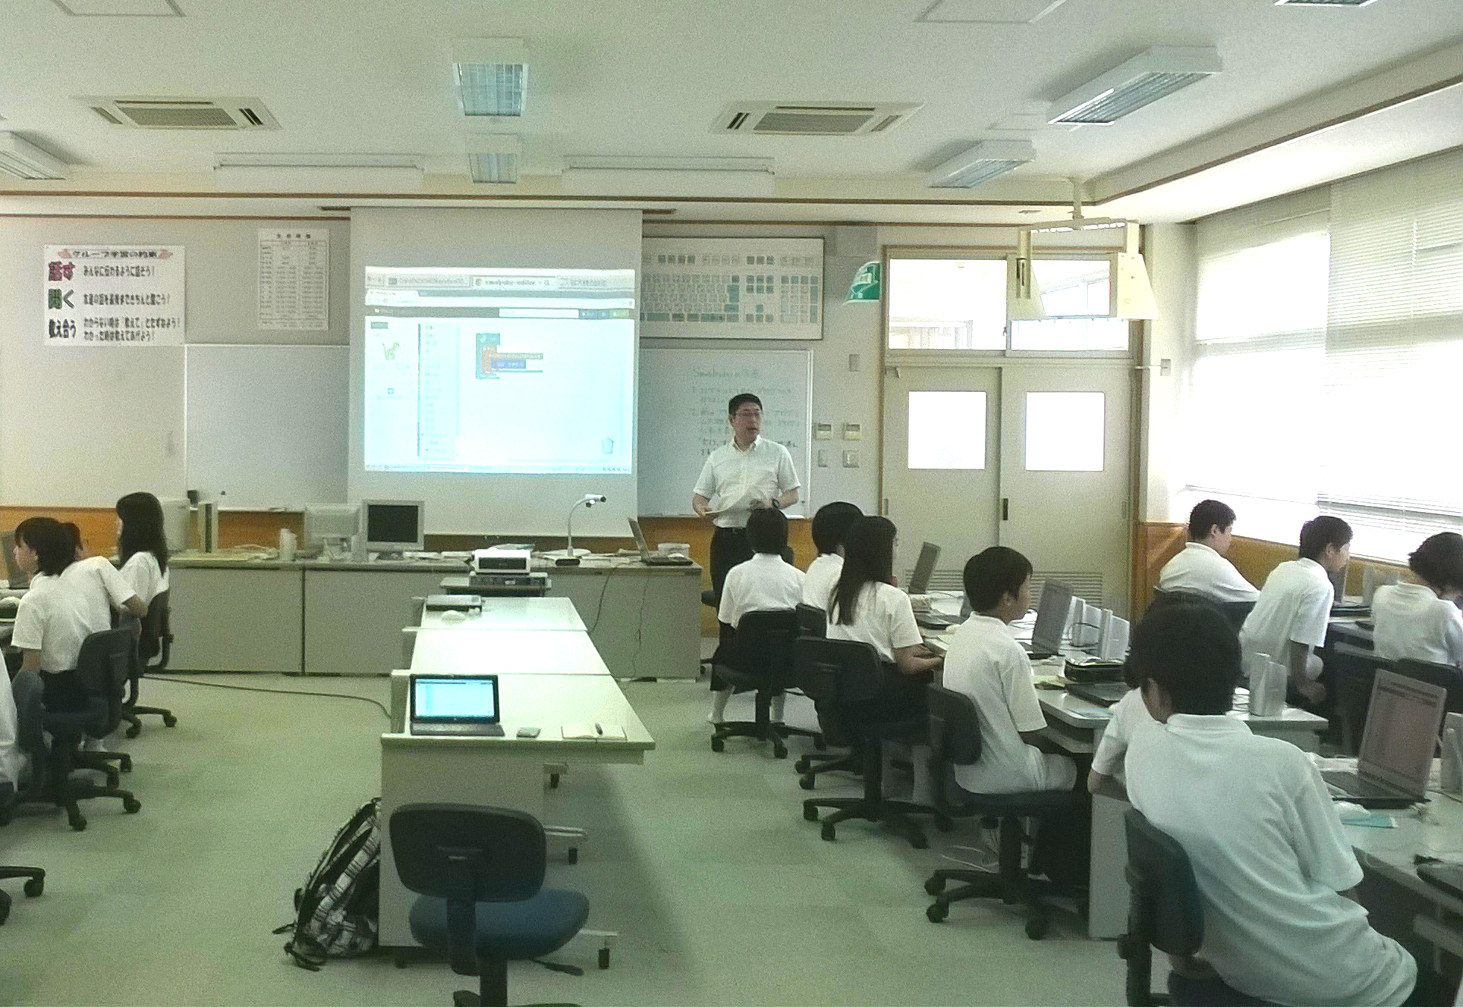
1 Teacher
Students
Notes:
Surprisingly,
<press>
they required no additional instructors
<press>
and the experiment was a huge success.

Slide 46
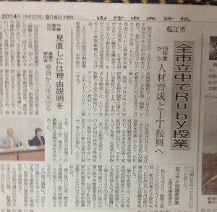
MATSUE CITY
Ruby classes in whole municipal Junior high school
By 09.04.2014/local news paper(Sanin Chuo Shinpo)
Notes:
Based on these result, the Matsue government decided to implement computer classes using Smalruby by April two thousand sixteen (2016).

Slide 47
91%
Junior high school students will Learn Ruby
Notes:
Right now, there are about six thousand (6,000) junior high students, municipal students cover around five thousand five handled (5,500) students… that means ninety one (91) % of the junior high school students will have Ruby classes pretty soon! That’s a lot of people, right? ☺
Matsue is just a start! Learning Ruby through compulsory education should take over the world!
Matsue is really, really the Ruby City, right?

Slide 48
The Ruby
Programming Shounendan
Notes:
Another topic.
Smalruby is designed for students that are over eight (8) years old. With that in mind, combined with my passion of preparing these “future programmers”, I’ve decided to create the Ruby Programming Shounendan.
The Ruby Programming Shounendan is an NPO for kids, that has been working under the banner of:

Slide 49
“Promoting the joy of programming to many kids. “
“Building internet safety awareness for kids through programming!”
Notes:
“Promoting the joy of programming to many kids. “ and
<press>
“Building internet safety awareness for kids through programming!“.

Slide 50
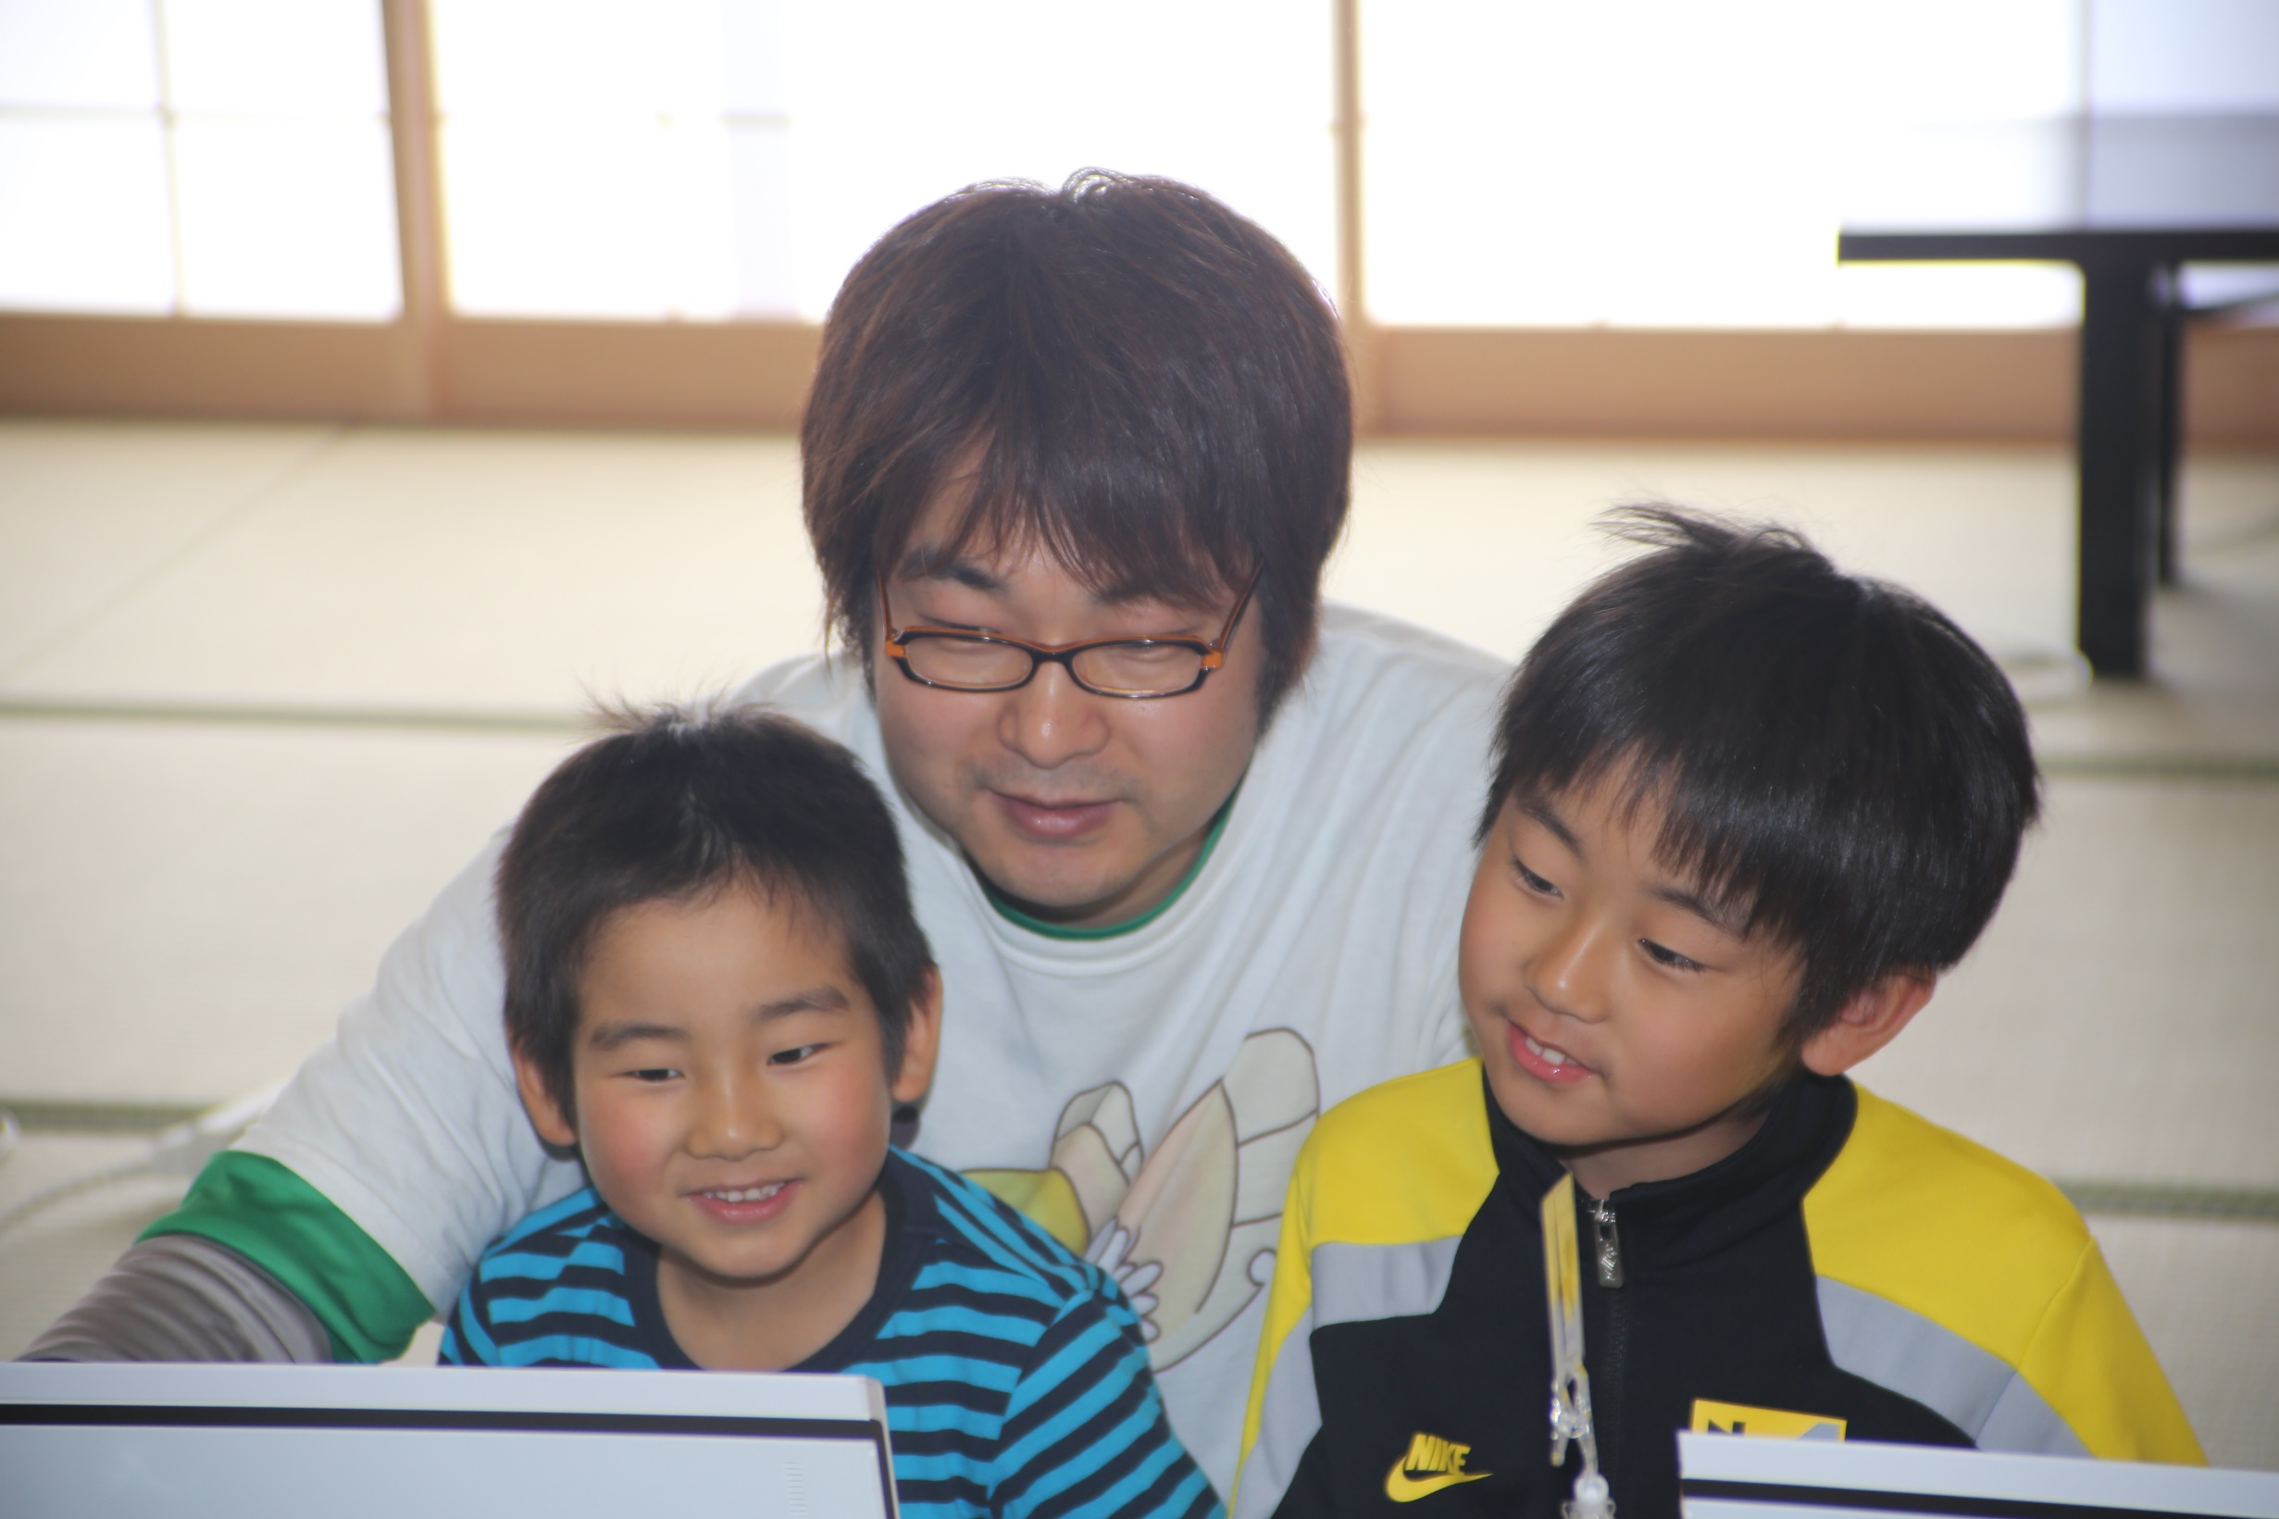
Ruby programming events for kids
and parents
Introducing Ruby,
once a month
Notes:
We have numerous activities. On the third Sunday of each month, we hold a ruby programming event for kids and parents.

Slide 51
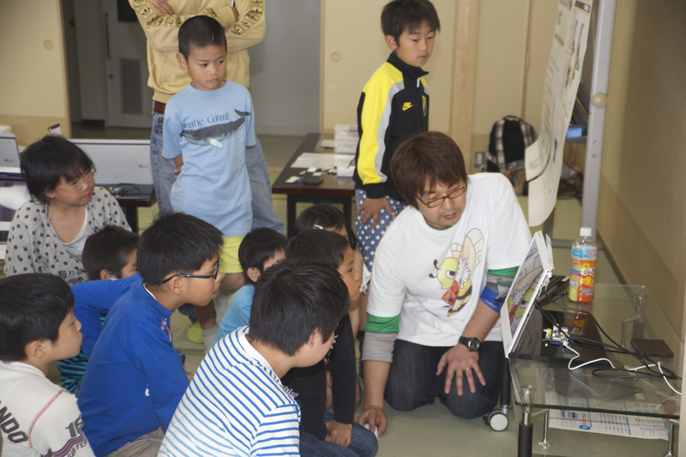
Notes:
These are photos from the event.
Right now I’m teaching them how to make a “car chase” game.

Slide 52
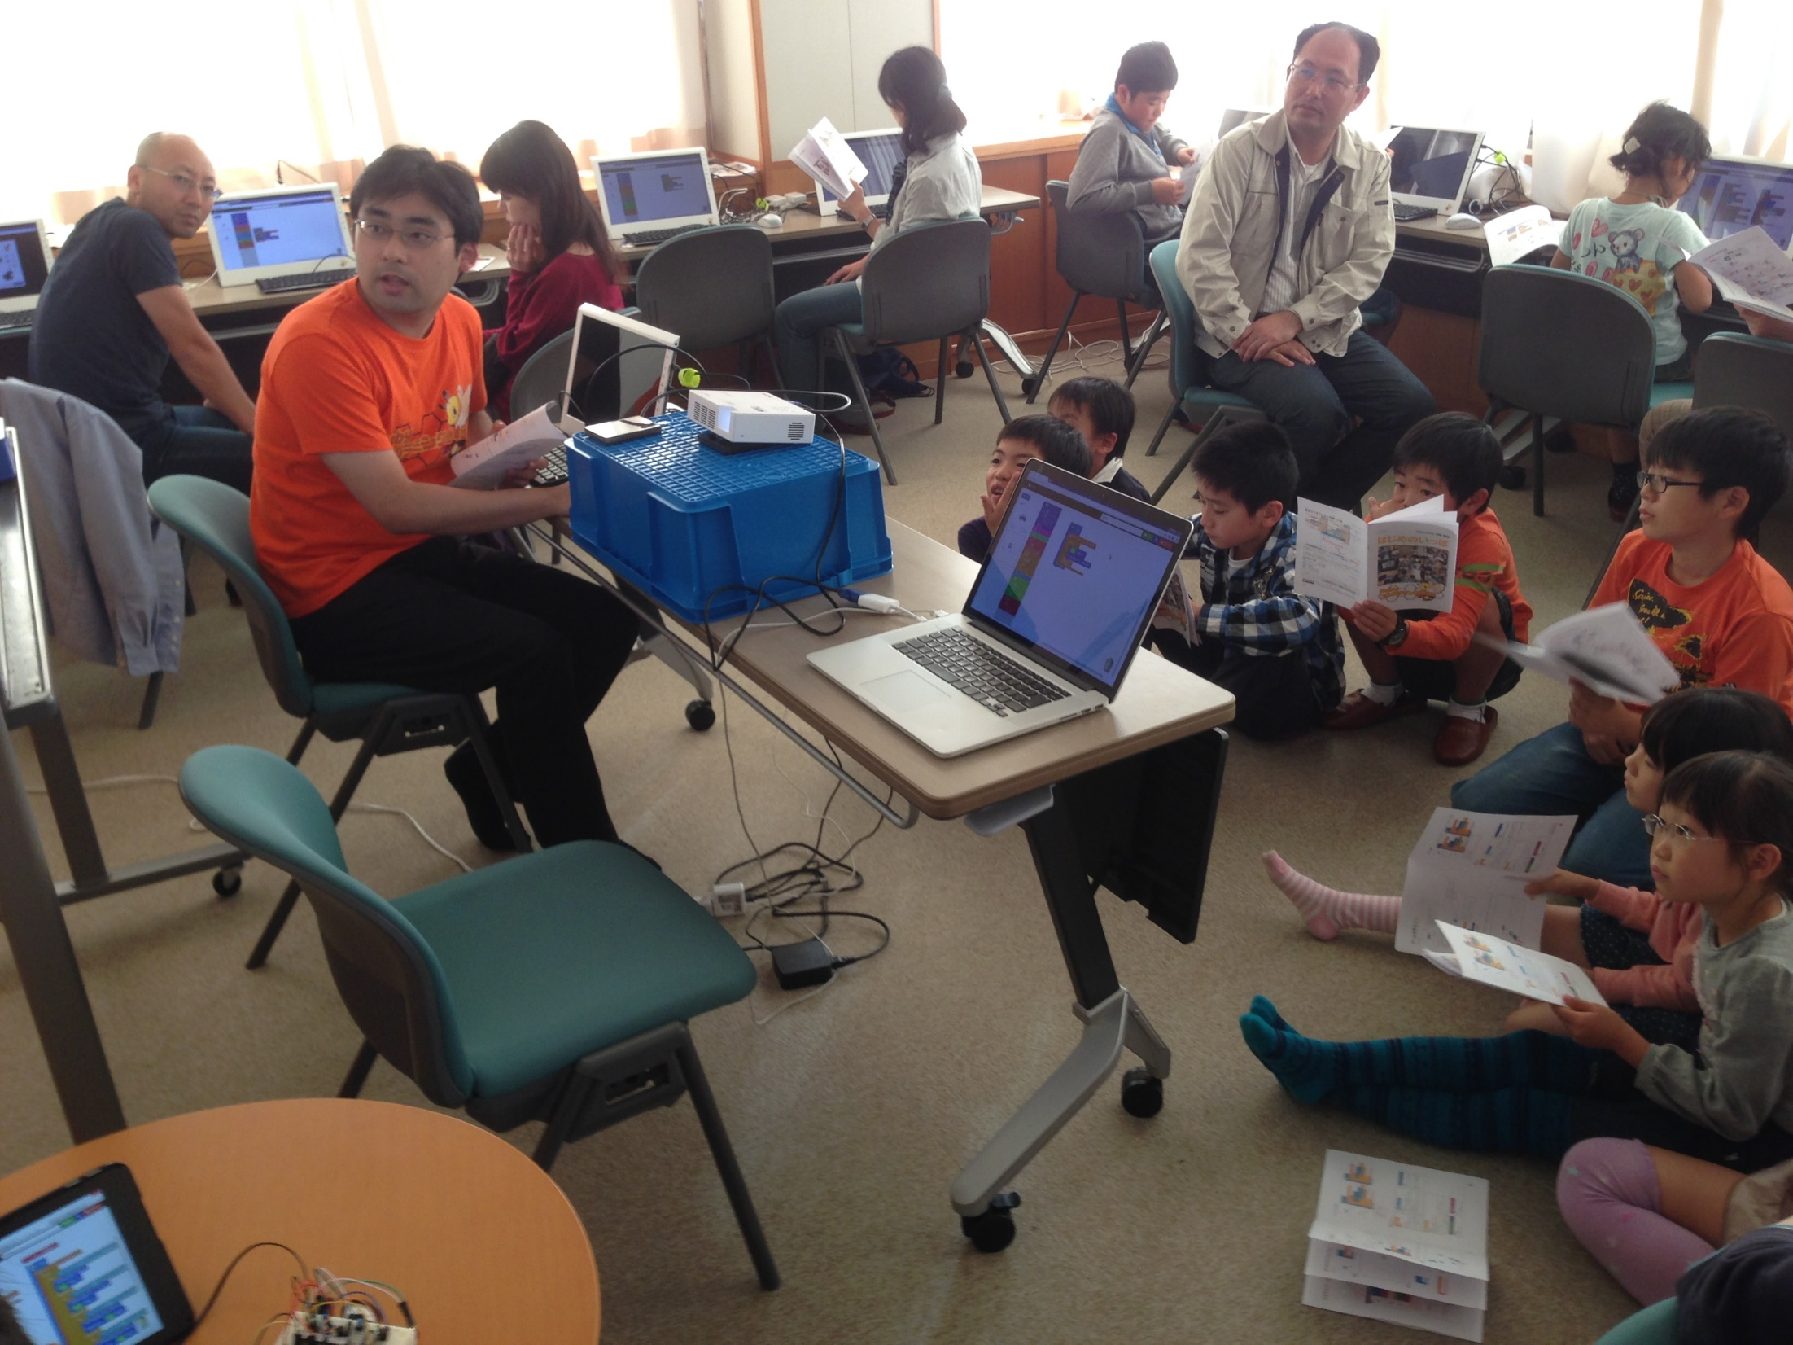
Notes:
This one is from a recent event.

Slide 53
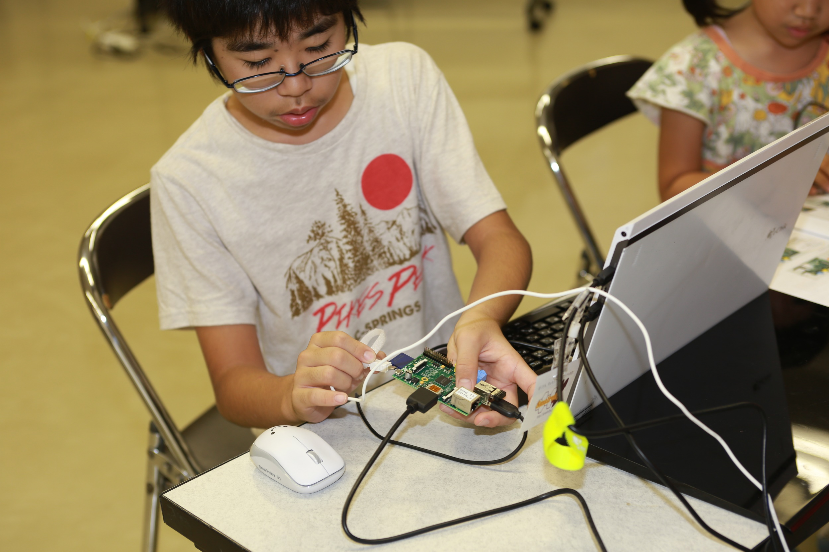
Notes:
That’s a Raspberry Pi.
The students are also in charge of assembling the components by themselves.

Slide 54
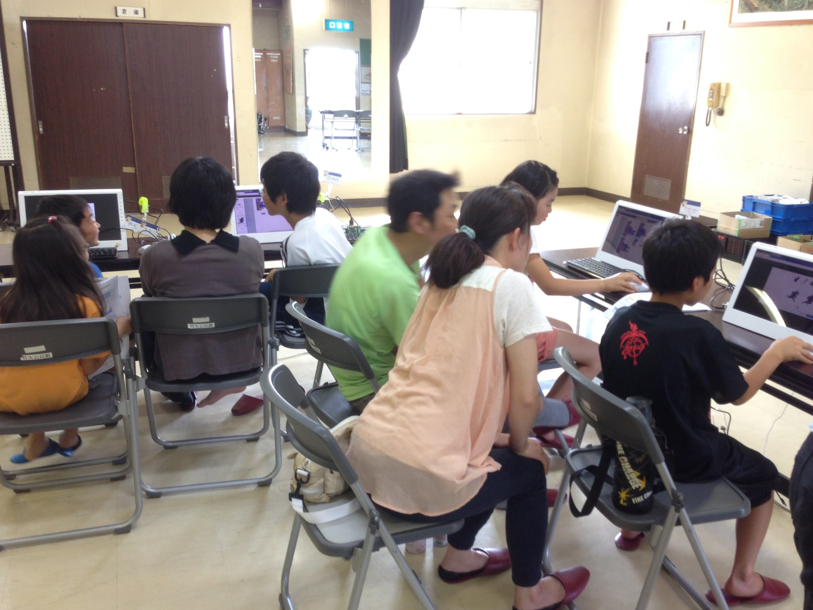
Notes:
Here are some parents supporting their kids.
They are always so willing to help their kids and that’s great !
But sometimes, we ask them to hold this impulse as hard as they can, so the kids can experiment a little and find the answers by their own effort.

Slide 55
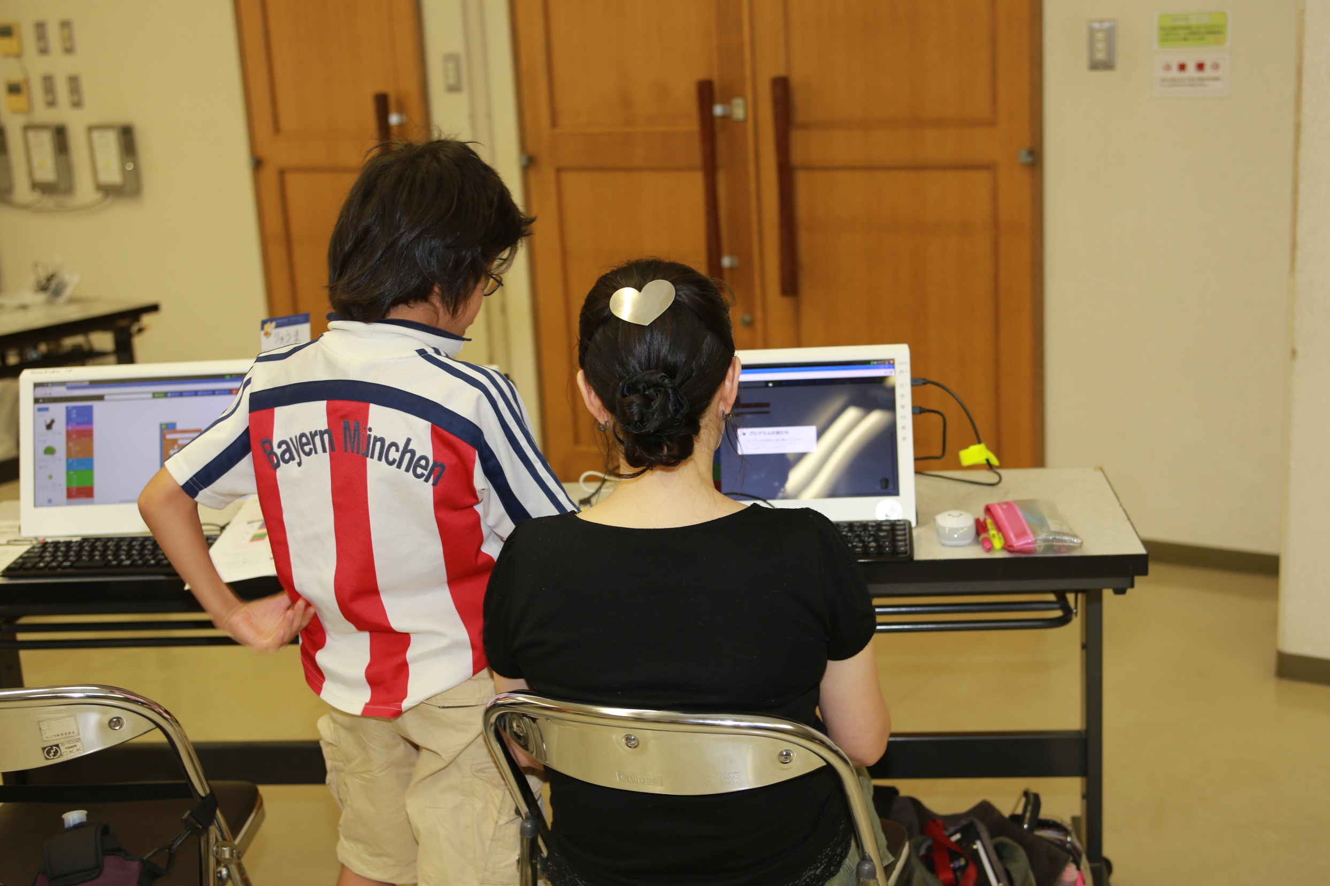
Notes:
Sometimes, the inverse process also happens. :D

Slide 56

Notes:
Whenever an interesting program is created in these events, we gather everyone and make a short explanation of what’s happening.

Slide 57
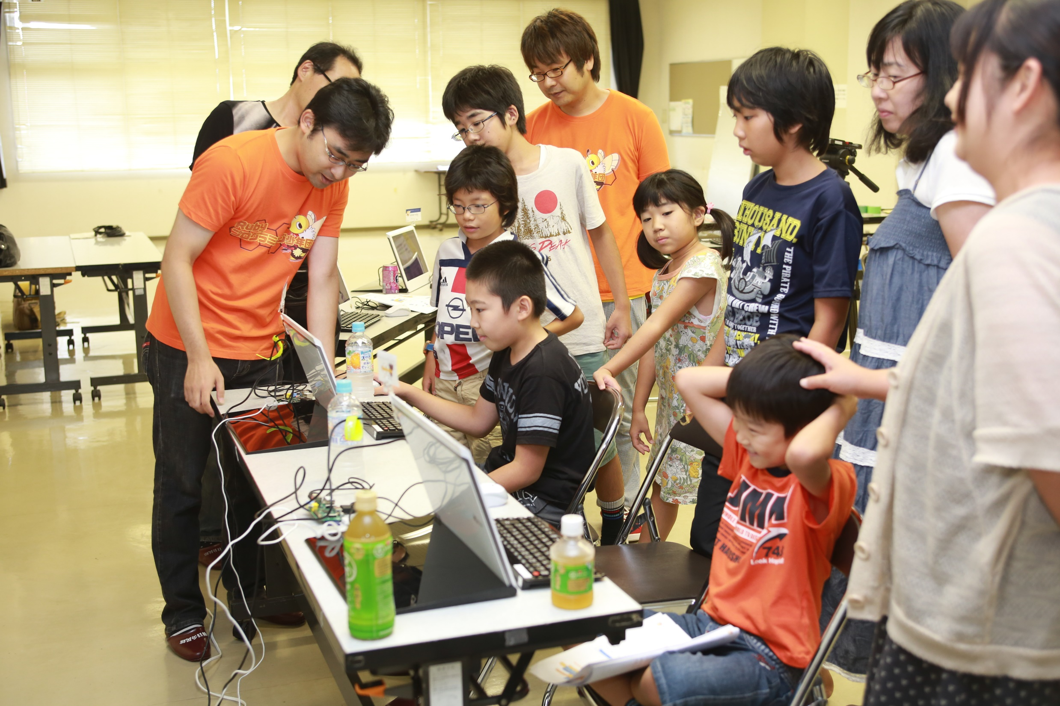
Notes:
It’s very fun !

Slide 58
CoderDojo Matsue
https://coderdojo.com
Free Ruby computer programming club for Kids,
once a month
Notes:
Also, we hold the CoderDojo Matsue on the fourth Saturday of each month.
The CoderDojo is the global network of free computer programming clubs for young people. It is managed by volunteers. The CoderDojo doesn’t specify which programming language or tools to use, so we are surely using Ruby.

Slide 59
Ruby Programming Shounendan
Team
≒
Tourna-ment
Coach
Youth Sports Club
Notes:
In the future, we will be like a youth sports club for soccer or baseball:
* There will be many teams
* Volunteer coaches
* With regional, prefectural (which is like a state) and national tournaments
We plan to make such an organization.

Slide 60

Welcome
Developers
GitHub:
smalruby/smalruby-editor
Notes:
Smalruby is developing by myself.
If you are interested,
<press>
<when I don’t have more time>
you try to use Smalruby, and teach kids using it.
<when I have more time>
Please implement some features then make a Pull Request.
So I will explain about Smalruby architecture and implementations.

Slide 61
Visual editor
Rails
Blockly
Notes:
Visual programming editor function of Smalruby, we have implemented as a Rails application.
The function, you can create a program with a combination of instruction block, to generate Ruby code, we have implemented using Blockly which is a JavaScript library and made by Google.

Slide 62
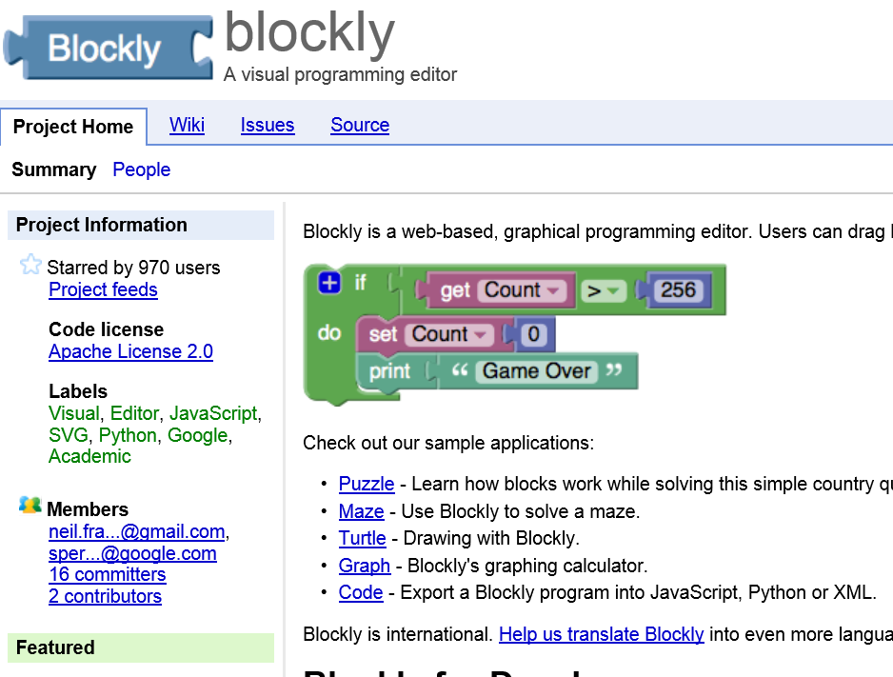
Easy to Use
Less Dependency
Small Runtime Size
Simple Installation
http://code.google.com/p/blockly/
Notes:
Blockly has developed using the Google Closure library, so dependency and runtime code size is small, the installation is simple.
Blockly is very easy to use and to develop a visual programming editor that runs on web browser.

Slide 63
Runtime
Windows:
DXRuby
Mac or Linux:
dxruby_sdl, Ruby/SDL
Notes:
A program that is created using Smalruby are run with DXRuby on Windows.
DXRuby is a rubygem. It provides functions that are 2D graphics, playback music and event handling to create 2D game.
Don’t worry if you use Mac or Linux, you also can use Smalruby using dxruby_sdl and Ruby/SDL rubygems that provide DXRuby compatible API, instead of DXRuby.

Slide 64

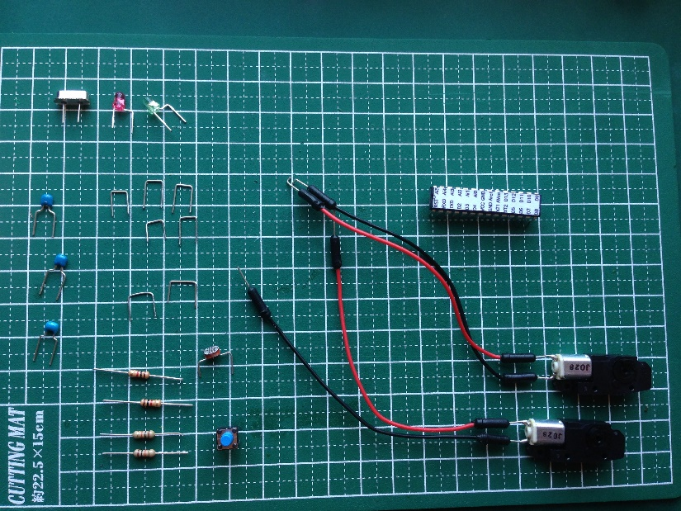
Smalrubot
Arduino
Dino
GitHub: austinbv / dino
Notes:
Smalruby is also able to control an Arduino based robot using Dino that is made by autinbv.
And, we provided a reference robot which is called Smalrubot, that:
* has two motor to drive its own,
* two led,
* and one Cds sensor.

Slide 65
Define Instruction Block
Blockly.Blocks['motion_move'] = {
init: function() {
this.setColour(208);
this.interpolateMsg(‘move %1 steps',
['STEP', ['Number'], Blockly.ALIGN_RIGHT],
Blockly.ALIGN_RIGHT);
this.setInputsInline(true);
this.setPreviousStatement(true);
this.setNextStatement(true);
}
};
/app/assets/javascripts/blocks/motion.js.coffee.erb
Notes:
Let's look at how to actually do to define the instruction block using Blockly.
This is the definition of the instruction block called "move 10 steps" the character that we showed you in the previous demo.
<press>
First, you name ‘motion_move’ to the instruction block then assign an object to it.
<press>
Next, you implement the initialization process of the instruction block to init property of the object.
Here,
<press>
* (SetColour) Blue
<press>
* (interpolateMsg) The label is “move blah-blah-blah steps”, and the ability to set the instruction block that represents a number which name is STEP
<press>
* (setInputsInline) Display on one horizontal row
<press>
* (setPreviousStatement) Connectable an other instruction block before this
<press>
* (setNextStatement) Connectable an other instruction block after this
<press>
We have specified the above.
With just of this, you can define the instruction block.

Slide 66
Generate Ruby from Block
Blockly.Ruby['motion_move'] =
function(block) {
var arg =
Blockly.Ruby.valueToCode(this,
'STEP',
Blockly.Ruby.ORDER_NONE);
return 'move(' + arg + ')';
};
/app/assets/javascripts/blocks/motion.js.coffee.erb
Notes:
In order to generate the Ruby code from the instruction block,
<press>
you can define a method that returns a string which is representing the code of Ruby, and that takes an instance of the instruction block which you defined.
Here,
<press>
* get the value of the instruction block that you specified in STEP,
<press>
* make the string “move(its value)”, and return it.
<press>
The good news, to put parentheses around by operator precedence and adjustment of indentation, framework of Blockly will do.
In Smalruby, The definition of the instruction block, and has realized the code generation of Ruby from the instruction block, are implemented using the framework of Blockly.

Slide 67

Ruby
Instruction Block
(歩動かす = move)
Notes:
Blockly doesn’t provide converting from the Ruby code to the instruction block, so we needed to implement it by myself.

Slide 68


Ruby
“Blockly’s XML”
(歩動かす = move)
Notes:
Finally it is the turn of Ruby.
In Smalruby:
<press>
* Send the source code of Ruby to Rails application
<press>
* Analyzes it
* Converts to XML of expressing the instruction blocks
<press>
* Returns the XML to the browser
* Reads the XML then displays as instruction blocks
We have implemented the conversion from the Ruby code to the instruction block in this way.

Slide 69
Translate Block from Ruby
class MotionMove < CharacterMethodCall
blocknize '^\s*' + CHAR_RE + 'move\((.+)\)\s*$',
statement: true, inline: true
def self.process_match_data(md, context)
md2 = regexp.match(md[type])
add_character_method_call_block(
context, md2[1], new, STEP: md2[2])
true
end
end
Notes:
This is a “Move (x) steps” instruction block.
<press>
Here on the first argument of the blocknize class method, we can specify a Regular Expression that will match a part of target Ruby code. Like Move and 10.
<press>
Also, in the process_match_data class method, the previous information is passed as the argument “md”, and a current parsing context is passed to the second argument. The context includes the current receiver which is usually a character, the current Ruby’s block and the current XML tree that are generated in this process.
Using “md”, this class method will transform the Ruby code into XML. Then, it will store it in the “context”. Like in this case, transforming into a Move(10) block.
<press>
Here the matched Ruby code is parsed the using the Regular Expression above.
<press>
Here in the add_character_method_call_block class method, it transforms the parsed information into XML, then it stores in the context.
<press>
Using this method, we are able to define a class corresponding to each instruction blocks and Ruby syntax. Allowing you to convert instructional blocks from the source code of Ruby.
The process is pretty simple, but there is still a lot of room to make everything better. So for anyone that is interested and wish to give us a hand, you are more than welcome to join!

Slide 70
Conclusion
Teaching Ruby Motivations
Ruby City MATSUE Project
TEACH MY SON RUBY
Smalruby
For over 8 years old
Ruby Programming Shounendan
Learning Ruby Organization for Boys & Girls
Notes:
Conclusion, in this presentation,
<press>
* I started to teach junior high school students Ruby. My motivations were Ruby City MATSUE Project and to teach my son Ruby.
<press>
* I have created Smalruby which is designed for over 8 years old and like Scratch.
<press>
* I started the Ruby Programming Shounendan which is a learning Ruby organization for boys & girls.
I explained.

Slide 71
I believe that people should focus on creating tools to help everyone.
Notes:
I believe that people should focus on creating tools to help everyone.

Slide 72
“Facing problems and looking for the answer that will solve them”
is a very important.
Notes:
Constantly facing problems and looking for the answer that will solve them, is a very important aspect of our jobs.

Slide 73
I sympathize with everyone here and …
Notes:
I sympathize with everyone here and …

Slide 74
I’m glad that we are all somehow involved with OSS development.
Notes:
I’m glad that we are all somehow involved with open source software development.

Slide 75
Ruby is
AND KIDS!
A Programmer’s
Best Friend
Notes:
Ruby is a powerful tool, a great answer for our problems.
<press>
So we have to try and do our best in order to provide these future kids, these future programmers, the best tool that we can offer and let them enjoy programming as much as we do.
And hopefully, in the future, they will do the same for their own kids.

Slide 76

THANK YOU
Smalruby (smɔ́ːrúːbi)
GitHub: smalruby/smalruby-editor
Email: contact@smalruby.jp
Twitter: @smalruby
Notes:
Thank you very much.
Now, I should say that “Do you have any questions?”, but unfortunately I can’t answer right now, because of my English, listening is no good, speaking is so bad.
So if you have a question, you could talk one to one after this presentation, sorry.
Thank you so much.

